Slide 1

Vivekanand College, Kolhapur (Autonomous) Department of Computer Science B.Sc. III (Computer Science) 2023-24
Submitted by :-
1.Priya Shivling Koneri .
2. Supriya Krishnat Kumbhar .
3.Pradnya Arun Mali .
4.Mrunali Maruti Patil .

Slide 2

“Online Green Metrics Calculator”

Slide 3
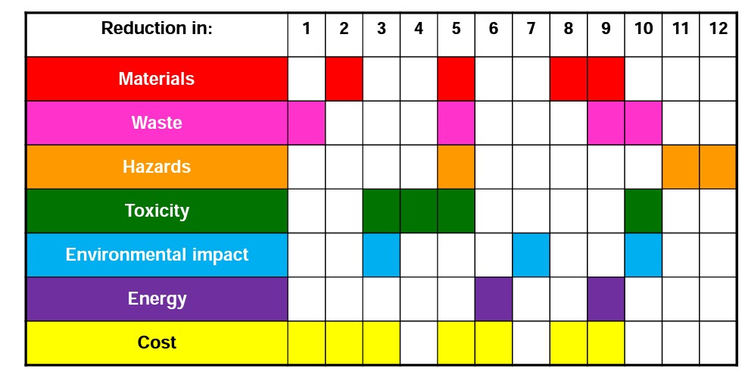
WHAT IS GREEN METRICS ?
The "Online Green Metrics Calculator" is a visionary software project designed to calculate green metrics easily

Slide 4
The chemistry department is conducting research on “ONLINE GREEN METRICS” and the difficult part of their research is to do 15-20 calculations for each product So, with this project we are going to create a software which will make these calculations easier and faster. Green chemistry metrics describe aspects of a chemical process relating to the principles of Green Chemistry.
One of the key advantages of the Online Green Metrics Calculator is its ability to save valuable time. Traditionally, calculating green metrics, such as carbon emissions, water usage, energy consumption, and waste generation, can be a time-consuming and labor-intensive process.
The Online Green Metrics Calculator automates these tasks, significantly reducing the time and effort required for these calculations.

Slide 5
OBJECTIVES
To measure the efficiency and environmental performance of chemical processes.
To find the efficiency and yields of the multi-component reaction.
To minimize errors while performing green metrics calculation manually.
To compare the various chemical processes and to choose best among them for further experimentation.
To represent chemical process data graphically for better analysis.

Slide 6
METHODOLOGY
PROJECT PLANNING
RESEARCH AND ANALYSIS
DATA COLLECTION
DESIGN
DEVELOPMENT
TESTING

Slide 7
EXISTING SYSTEMS
PMI Predictor | Calculates process mass intensity (PMI)
iGAL 2.0 Scorecard Calculator | Produces the scorecard output for an active pharmaceutical ingredient (API)
AMGS Calculator | Calculates an analytical method greenness score (AMGS) to enable the comparison of separation methods used in drug development
Chemotion | Open Source electronic lab notebook for researchers with a green chemistry tab
CHEM21 toolkit | Evaluating sustainability of reactions, covering quantitative and qualitative criteria both upstream and downstream of the reaction itself

Slide 8
PROJECT PLAN
PROJECT INITIATION
REQUIREMENT ANALYSIS
DESIGN
DEVELOPMENT
TESTING
DEPLOYMENT

Slide 9
CONCLUSION
In conclusion, the “Online Green Metrics Calculator” stands as an indispensable tool for efficiently calculating and tracking green metrics while saving valuable time.
The Online Green Metrics Calculator not only facilitates accurate and rapid calculations but also encourages a proactive approach to environmental responsibility.

Slide 10


